Slide 1
Team APPY FIZZ
Ahish Deshpande (AD) (2018102022, ECE)
Pranav Kirsur (PK) (2018101070, CSE)
Pranav Tadimeti (PT) (2018101055, CSE)
Yoogottam Khandelwal (YK) (2018101019, CSE)
Friend Blend
Mentor TA: Adhithya Arun
Repo URL: https://github.com/Digital-Image-Processing-IIITH/project-appy-fizz

Slide 2
Problem Description

Slide 3
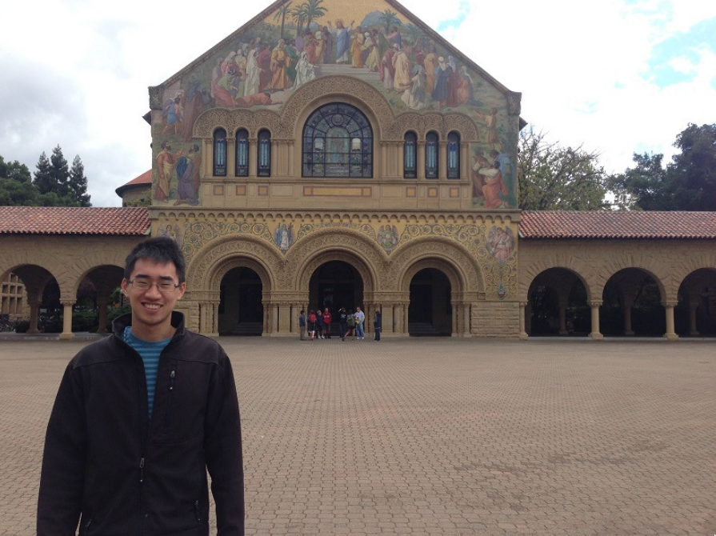
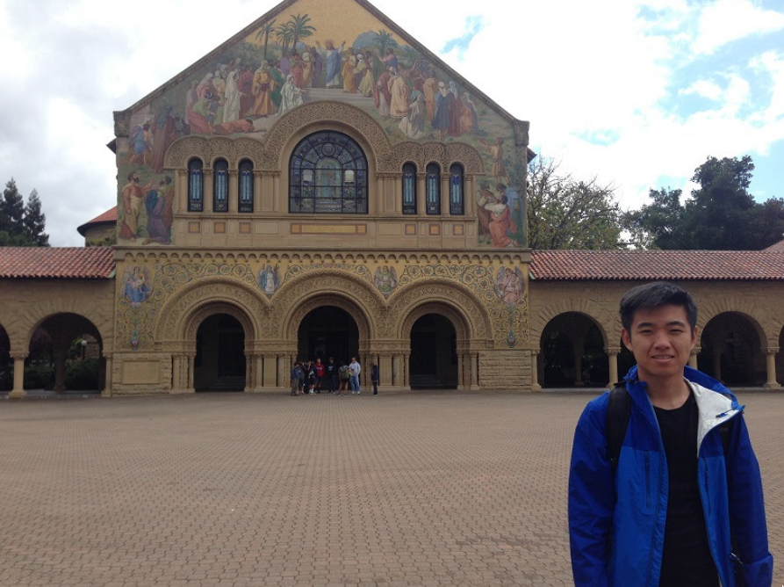
Problem Description
Two friends don’t want to take a selfie, maybe because of camera resolution.
Want to have a picture together, nobody around to take it.
Two people visit the same place at different times but want to have a picture together at that place.
Notes:
Two friends put same teams/zoom background but want a picture together

Slide 4
Project Paper Introduction

Slide 5
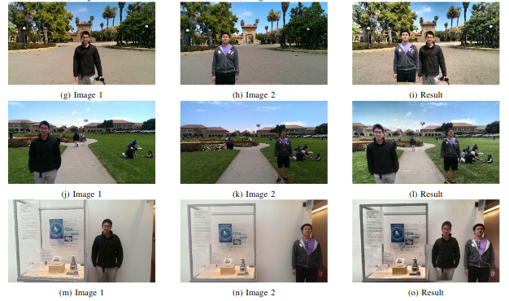
Project Paper Introduction
Given two input images, our goal is to create a third image with both Person A and Person B in the photo together.
The FriendBlend algorithm mainly relies on segmentation and registration techniques for extraction and merging images.
Notes:
The authors of the paper made an assumption that there would be only one face in the input to get a reasonable output.
Provided assumptions are met, and implementation is correct, the results of the method described are quite convincing.
While more reliable techniques than the ones used in FriendBlend exist, they often sacrifice computational efficiency. Given the use of the algorithm in a mobile application, it is justified to use these less reliable techniques.

Slide 6
Project Pipeline

Slide 7
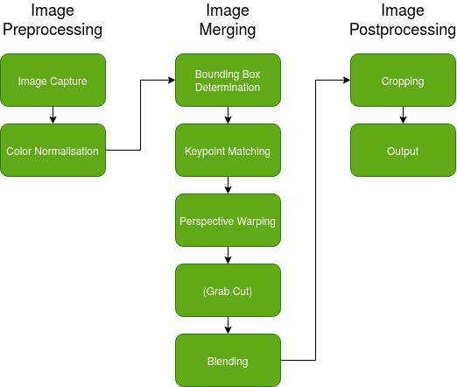
Process

Slide 8
Stage 1: Color Correction

Slide 9
Contrast Limited Adaptive Histogram Equalization
It is crucial to make sure that the lighting from the two input images are approximately the same before the blending process to make the final image look realistic
This is especially important as the colors in the image affect the homography output

Slide 10
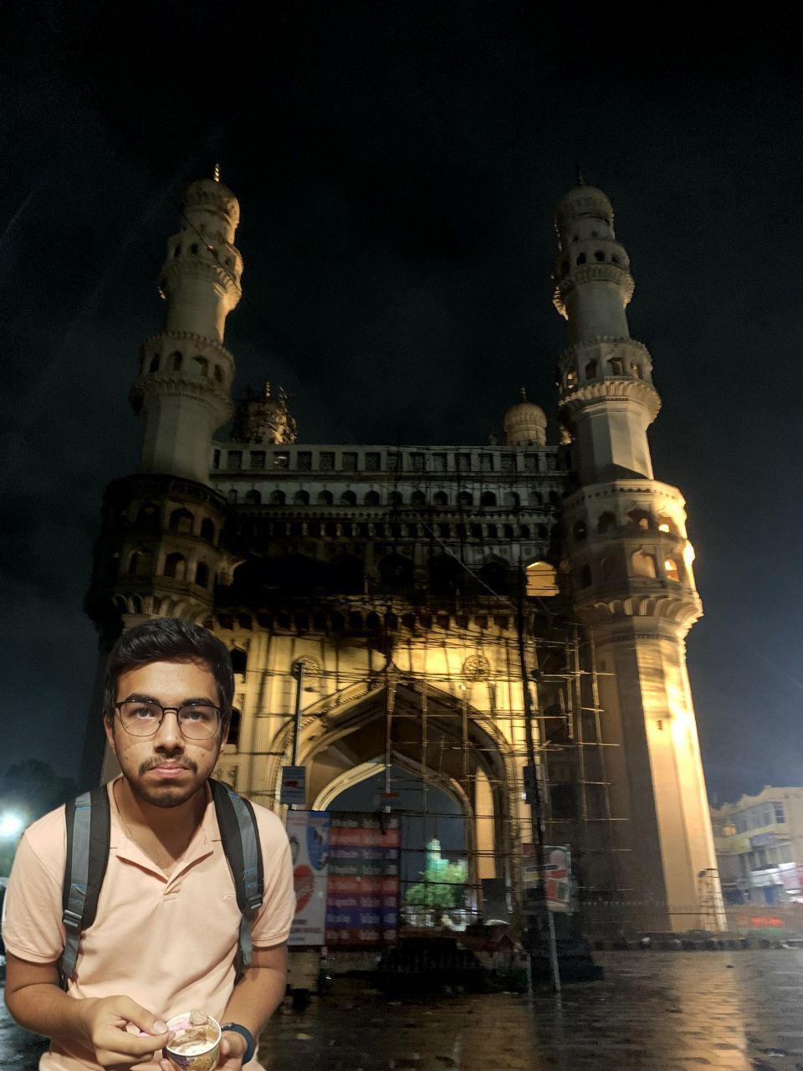
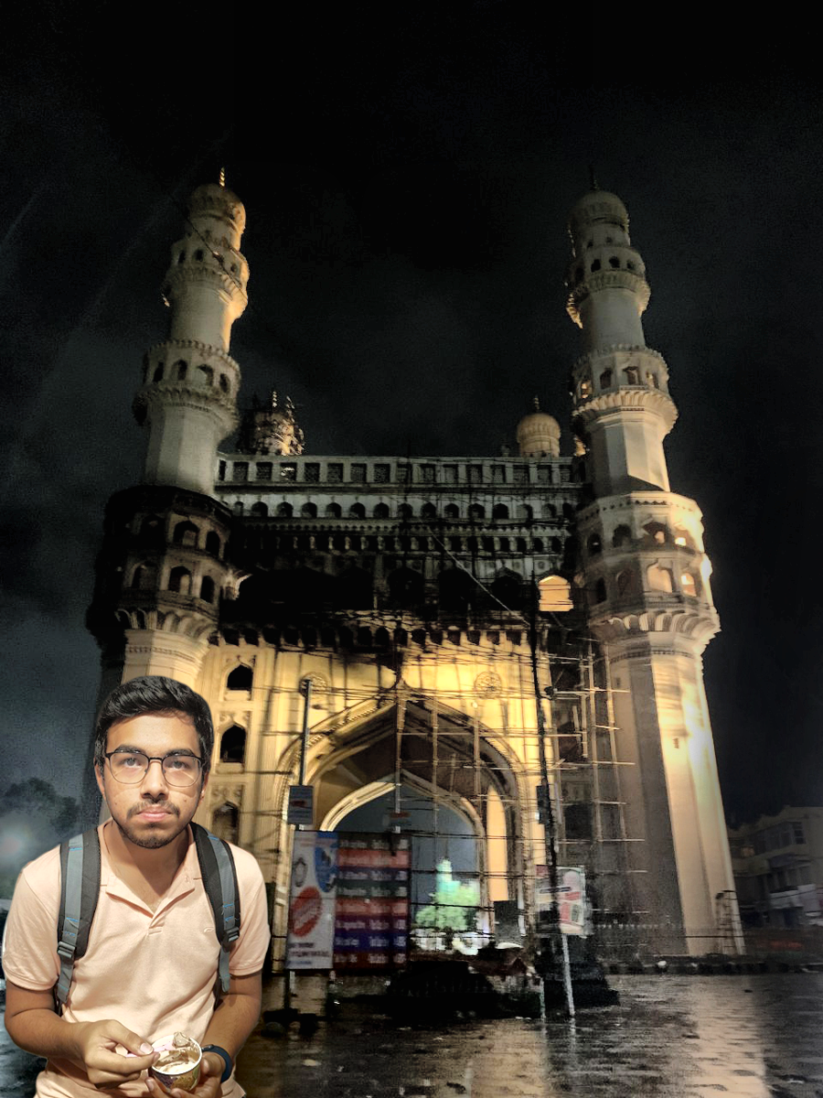
Input Image
Output Image

Slide 11
Stage 2: Face and Body Detection

Slide 12

Face Detection
with Haar Cascade
Notes:
Implemented ourselves

Slide 13
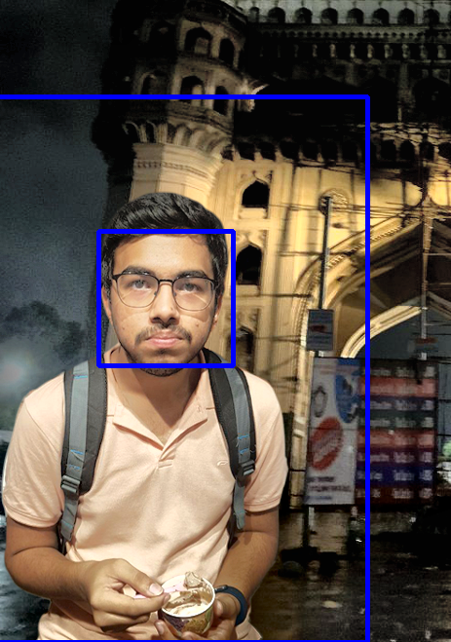
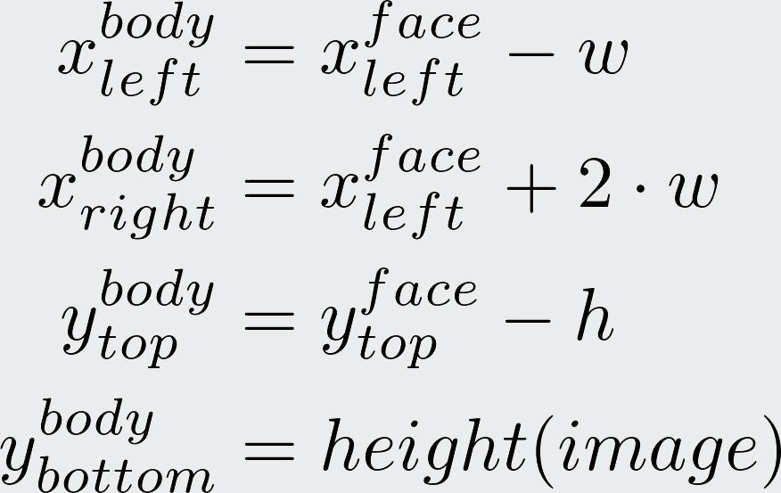
Body Bounding Box
inferred from face
Notes:
Implemented ourselves

Slide 14
Stage 3: Homography Estimation

Slide 15
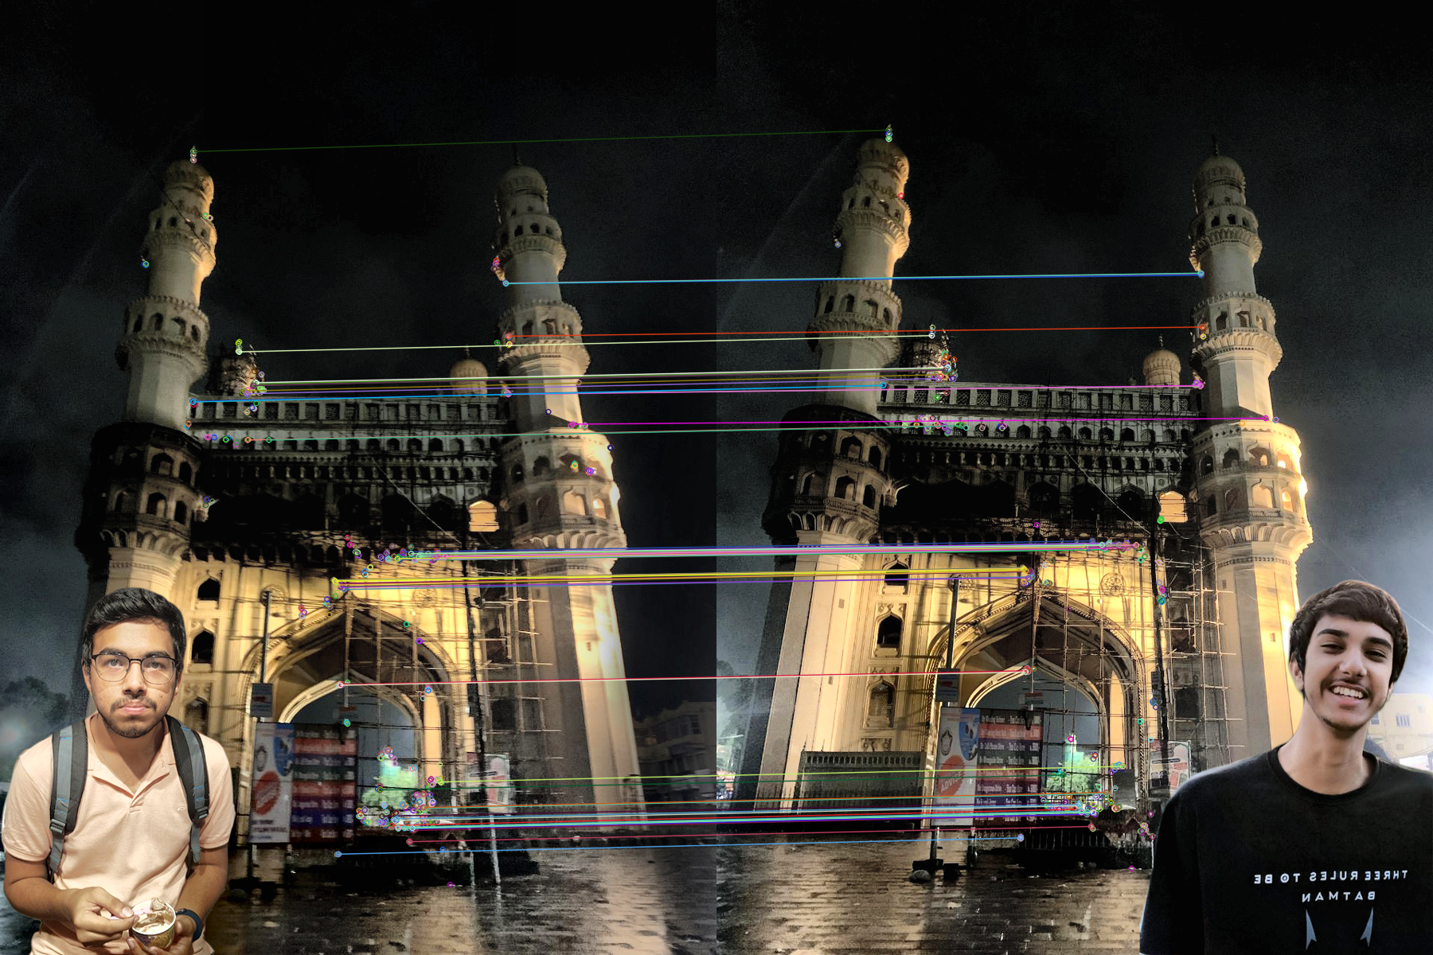
Keypoint Detection
and Matching
We use ORB features
Keypoint filtering based on bounding boxes and distance in the image
Keypoint matching based on Hamming distance
Notes:
Implemented ourselves

Slide 16
Stage 4: Image Blending

Slide 17
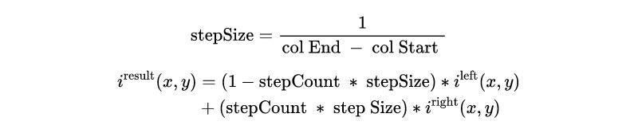
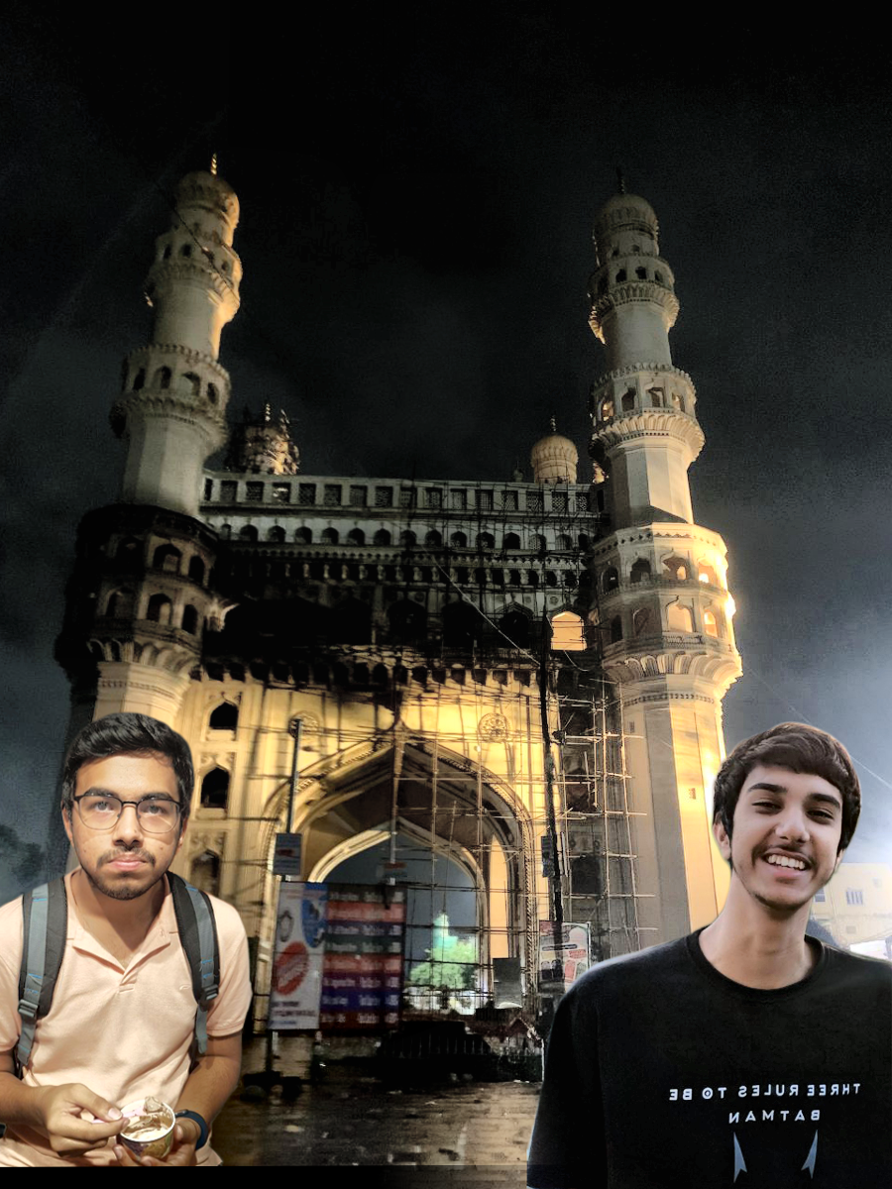
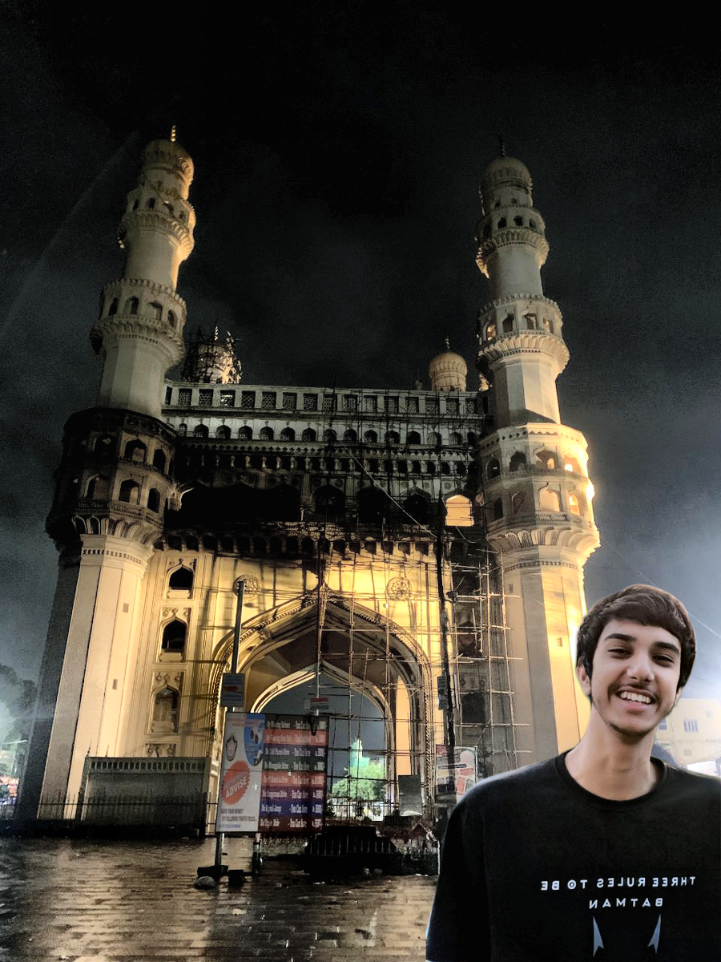
Alpha Blending
Adopted when subjects
are far apart
Notes:
Implemented ourselves

Slide 18
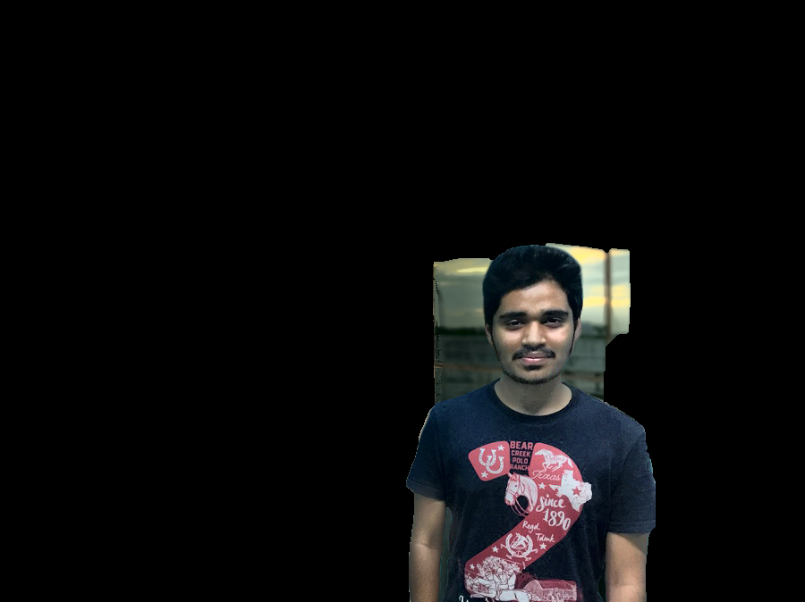
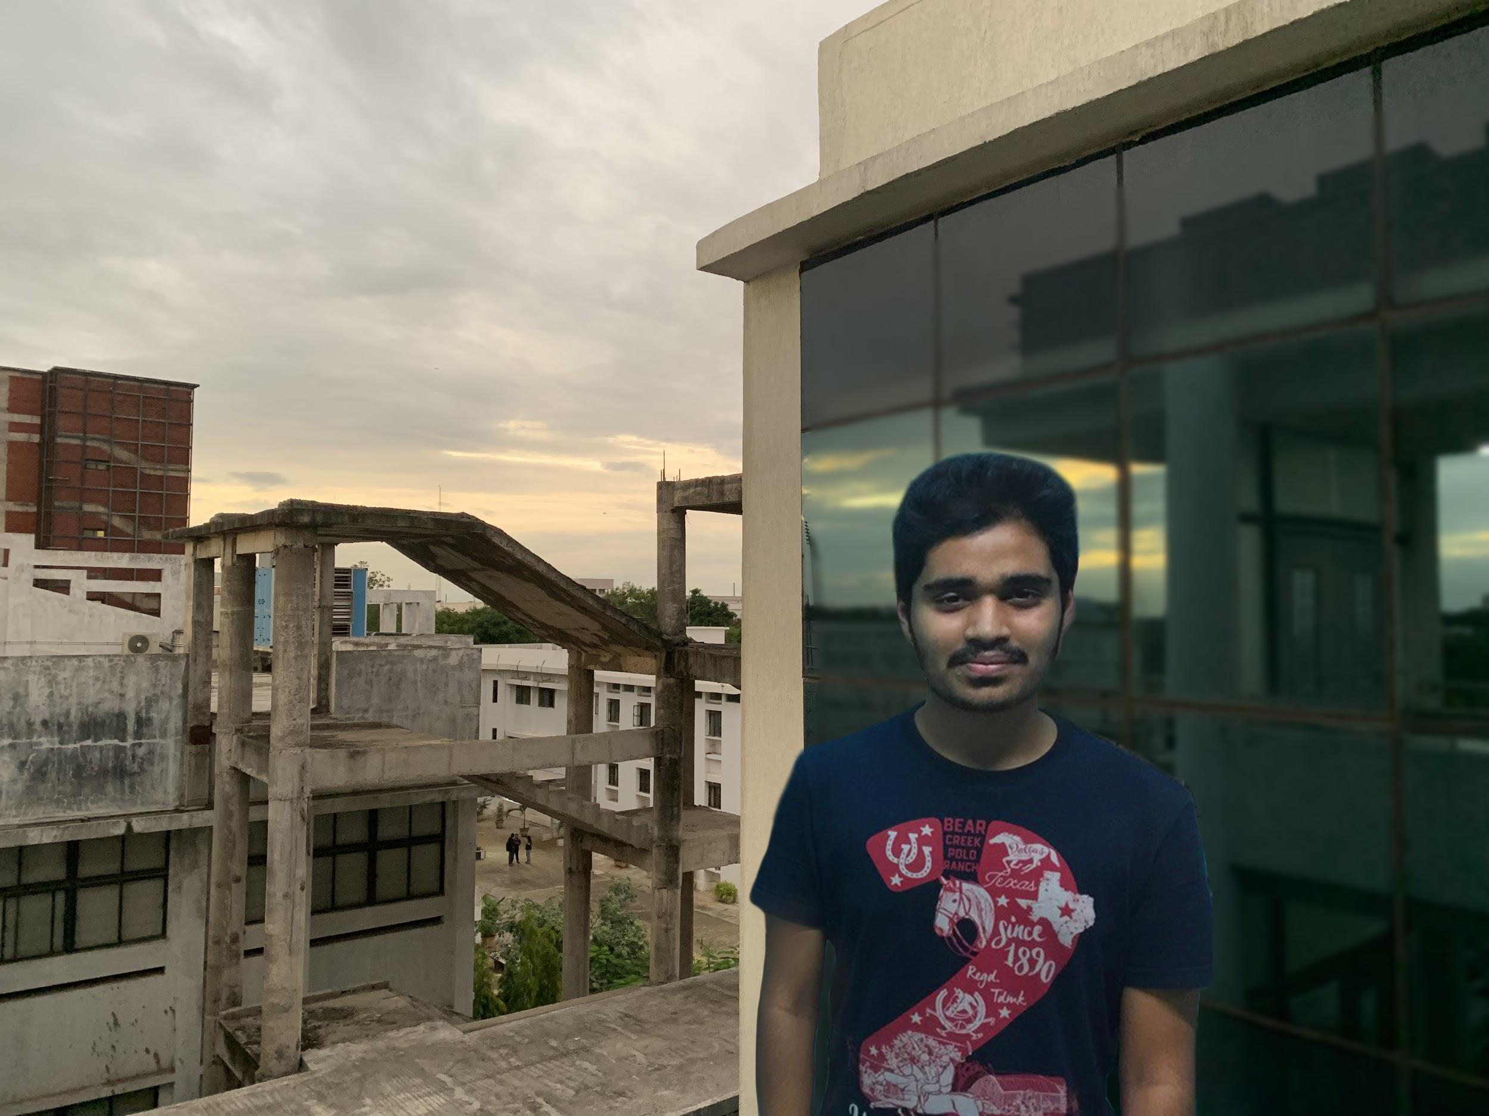
GrabCut
Used when subjects are very close to each other
Initial mask for GrabCut constructed from bounding boxes.
Face labelled as definite foreground.
Area below face labelled as probable foreground.
Notes:
Own implementation, show outputs
Using library function because it’s much faster (c vs python)

Slide 19
Results

Slide 20
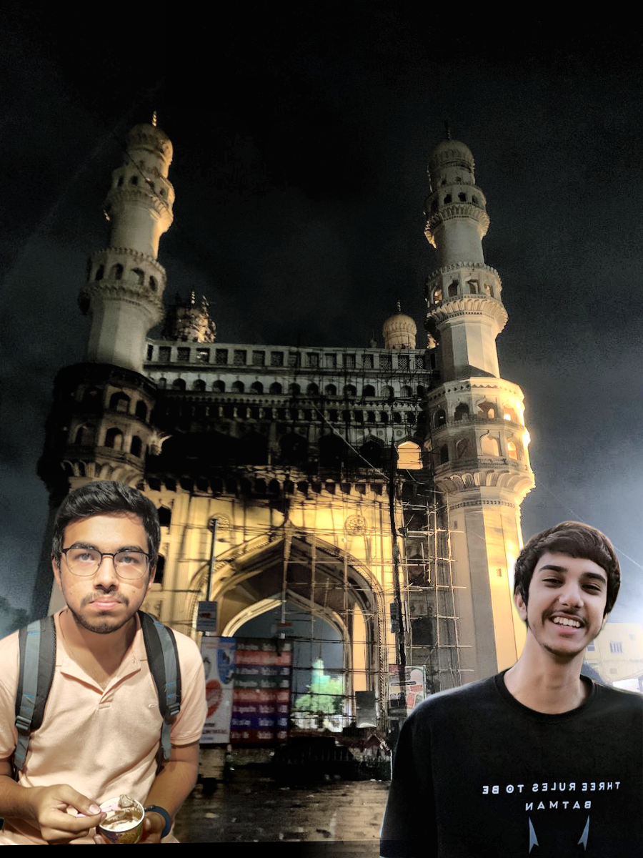
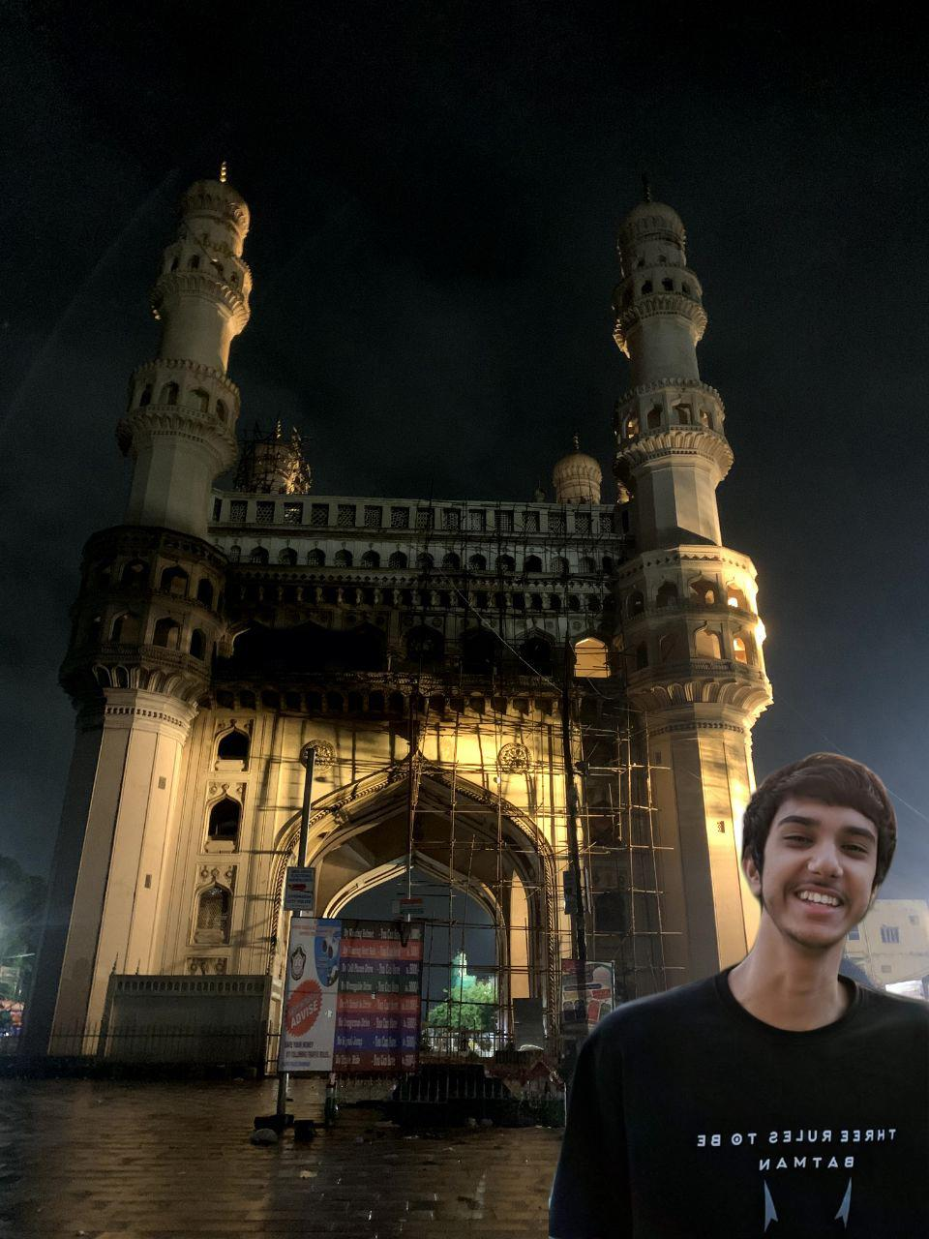
Notes:
Alpha blending

Slide 21
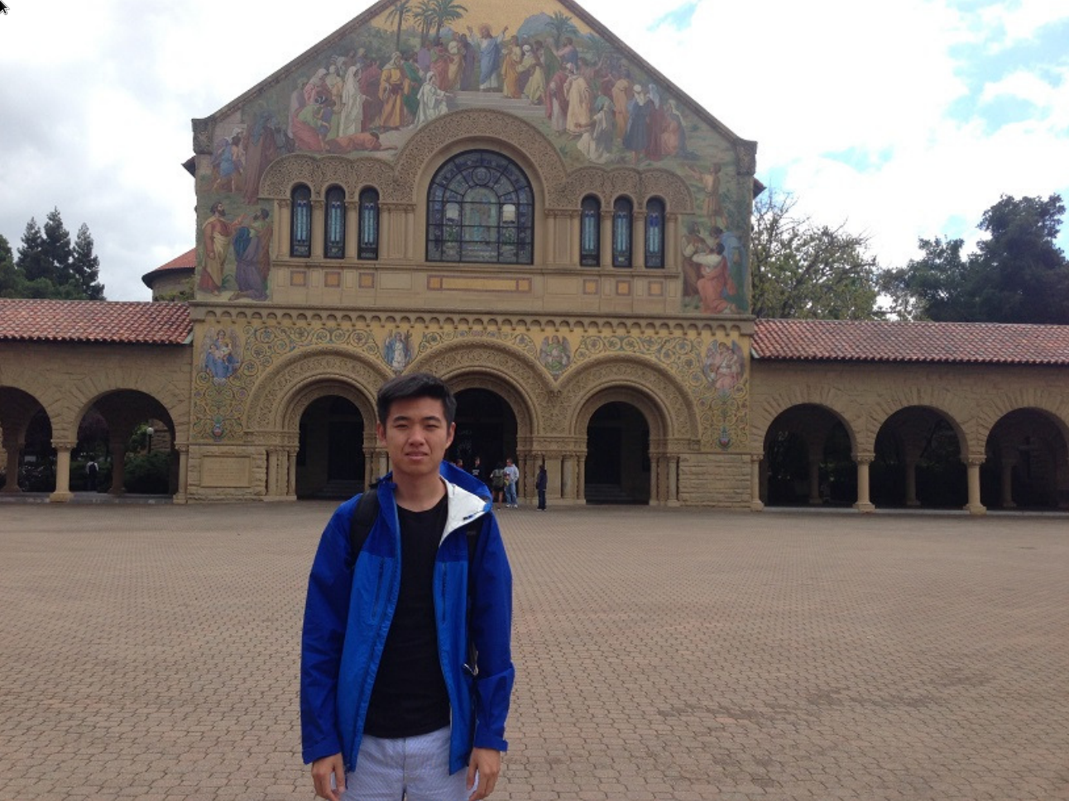
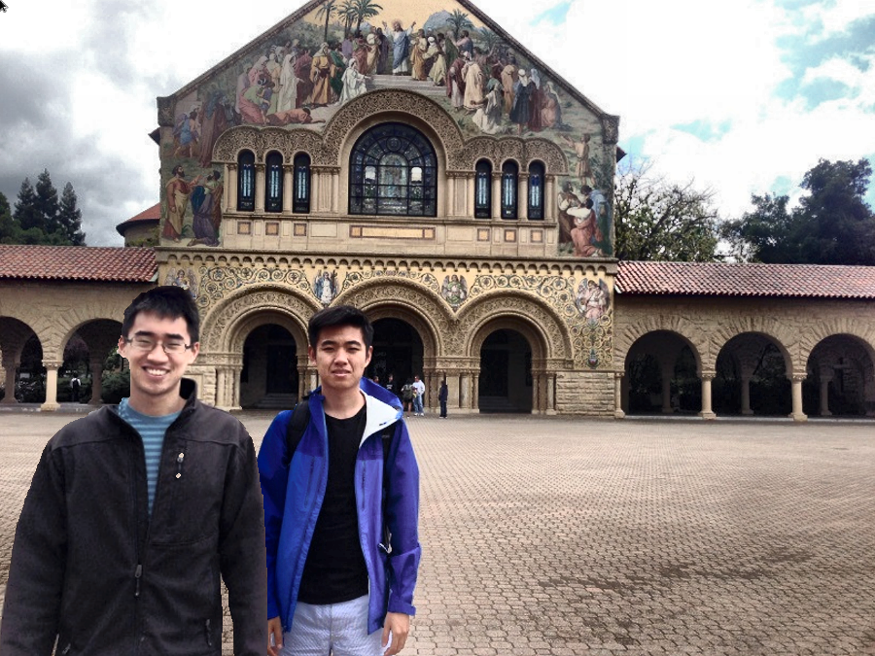


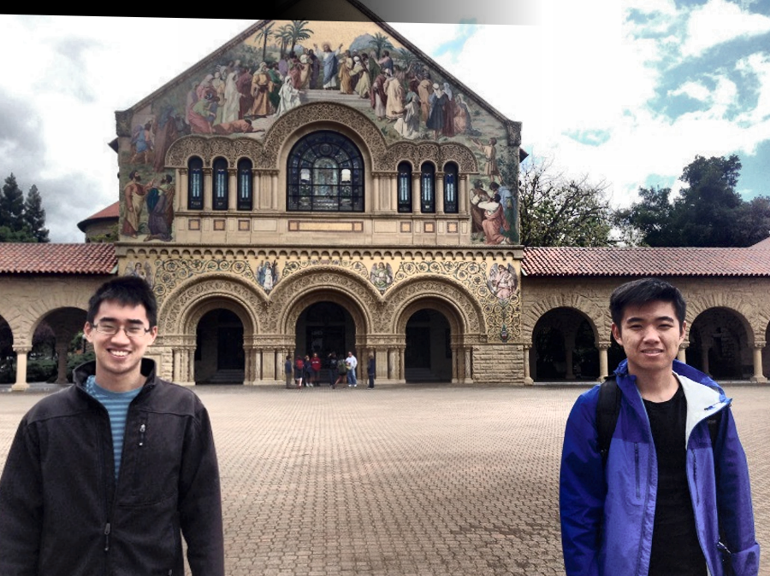

Slide 22
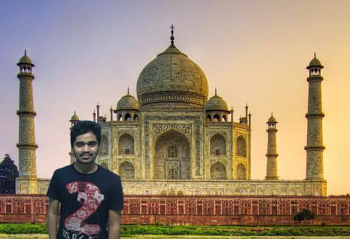
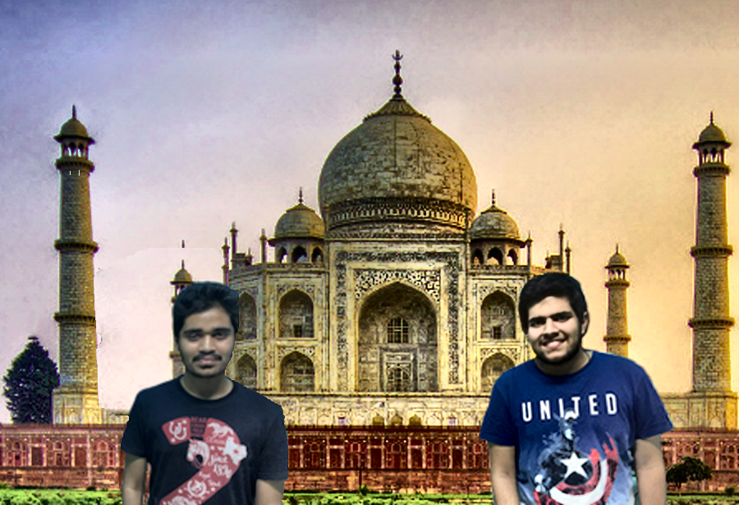
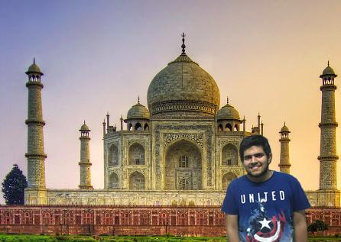
Notes:
Alpha blending

Slide 23
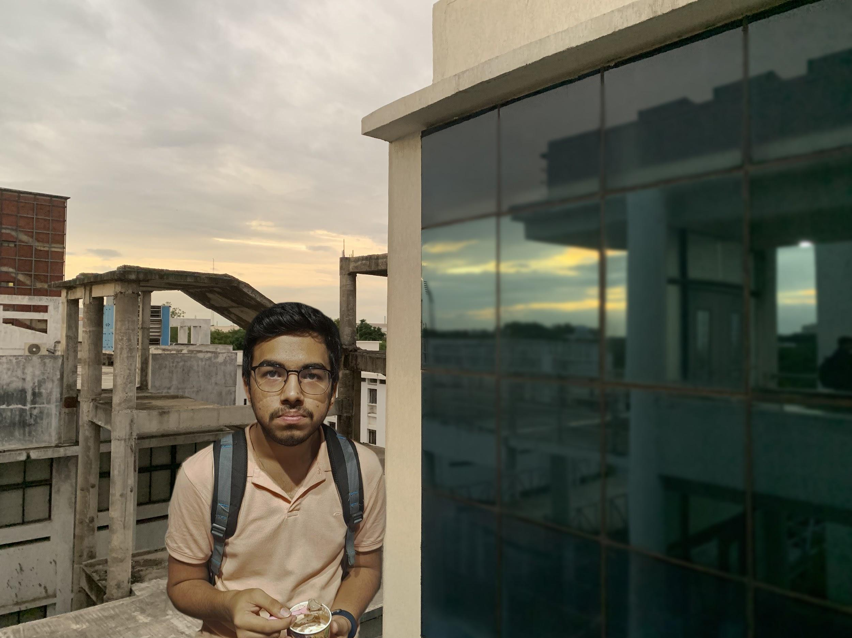
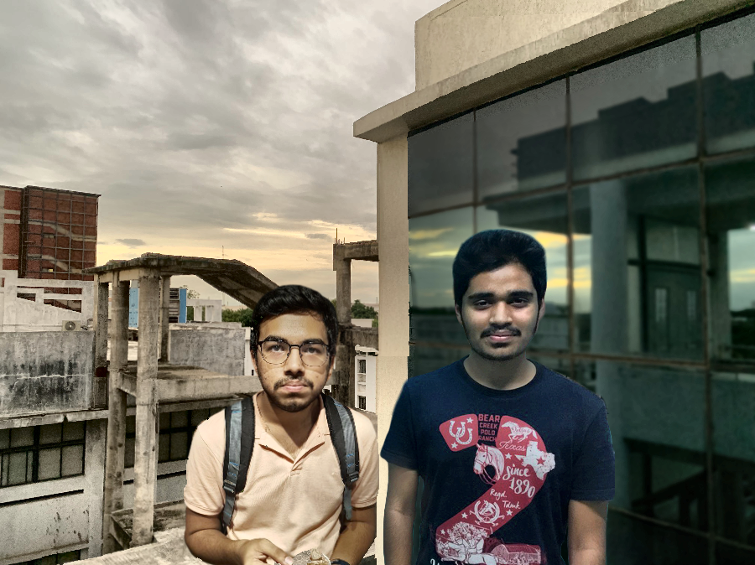
Notes:
Grabcut

Slide 24
Limitations

Slide 25
It’s not perfect!
Face detection is not always perfect. Possible solutions:
Swap haarcascade with current SOTA, RetinaFace: Single-stage Dense Face Localisation in the Wild [code]
Homography is not always computable or incorrect. Possible solutions:
Using optical flow for matching the perspective in both images
GrabCut doesn’t work perfectly. Possible solutions:
Swap GrabCut with current SOTA, [Hierarchical Multi-Scale Attention for Semantic Segmentation] [code]
Calculate more accurate mask by having minimal user input
Sometimes Color Correction gives a makeup-ish feel to the face
Only works with 2 images, with a single face in each of them
Notes:
Describe how each of these fail
Face detection: recognizes something else as a face, unable to find a face at all
Homography: not enough keypoints found, not enough matches found (either after bounding box pruning or after ransac), homography not computable even after all this
GrabCut: classifies a lot of the background as foreground which overwrites the other person, leaves some artifacts which are clearly visible
Color correction depends on clip_limit. Any fixed value will not work for all images and lighting conditions. Solution: create a metric and run with different parameters

Slide 26
Examples

Slide 27
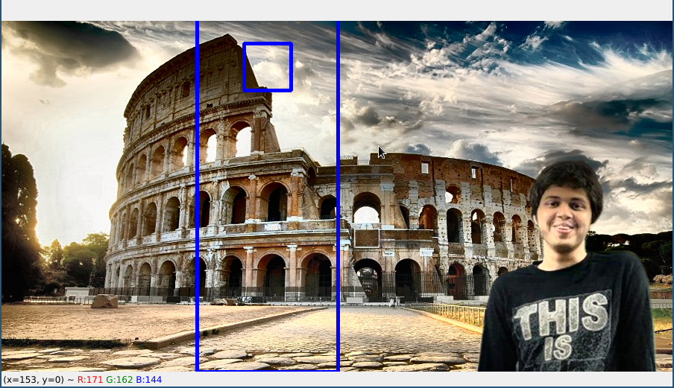
Face detection failing

Slide 28
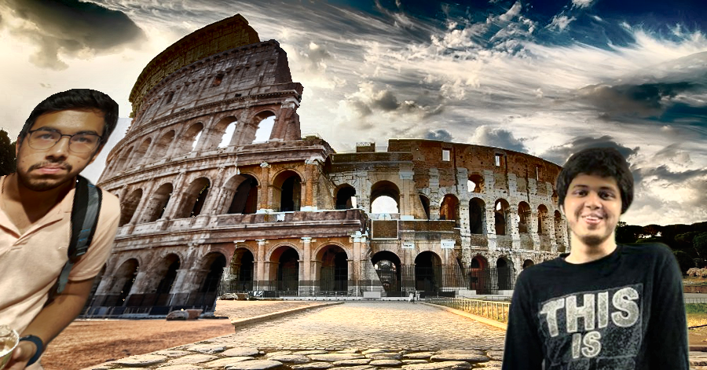
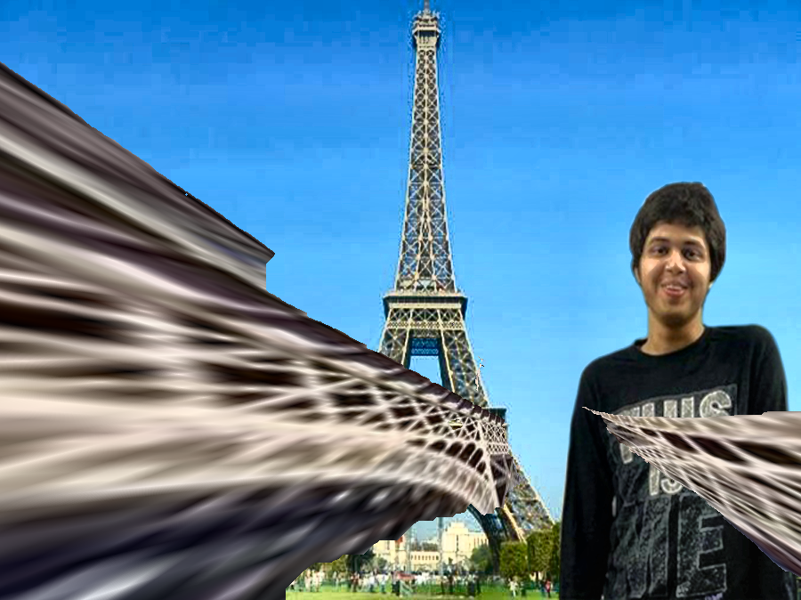
Incorrect Homography

Slide 29
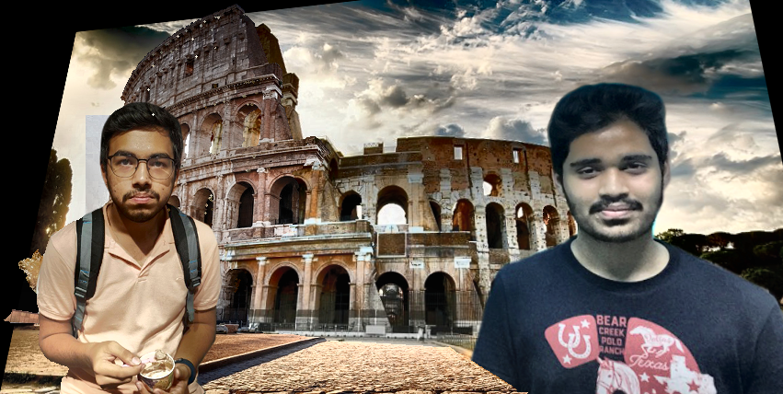
GrabCut leaves artifacts
Notes:
Around yoogottam’s face
This happened because grabcut considered the differently coloured sky to be a part of foreground

Slide 30
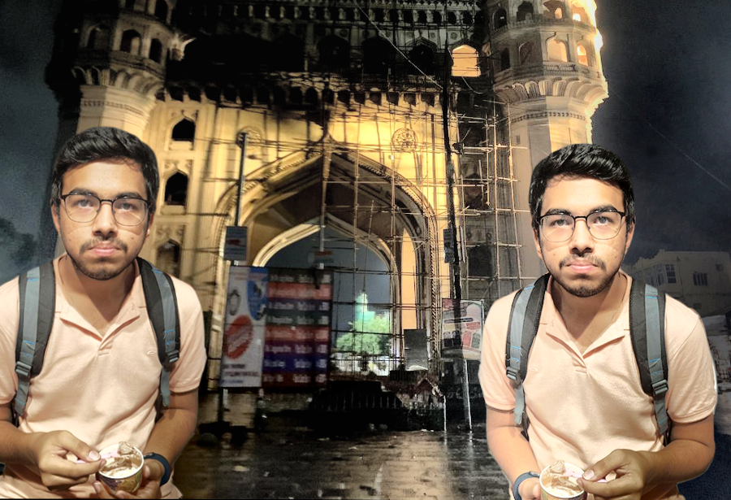
Color Correction in presence of extra light
Notes:
Right face looks unnatural

Slide 31
Conclusion

Slide 32
It works!
In most of the cases the results are very realistic.
We mostly stuck to the paper’s details and parameters but we deviated from it in a few cases to get better results.
Added a small margin to face bounding box mask in GrabCut, to ensure hair is not cut off.
Connected components on mask with face center as seed
We achieved 2x speedup by parallelizing the independent steps in the pipeline.
Although we implemented GrabCut, it took about 60x more time (4s -> 4m) so we ended up using library cv.grabCut instead
Notes:
2x speedup parallelized
Color correction
Face and body detection
Grabcut Time taken is much more because
Naive implementation
Everything in python whereas opencv in C/C++

Slide 33


GrabCut result improvement

Slide 34
Contribution
Color correction: AD
Face and Body detection: PT
Keypoint matching and Homography: YK, PK
Blending:
Alpha Blending: AD
GrabCut: AD, PK, PT
GrabCut result improvement: YK
Cropping: PT
Runtime Optimization: YK
Limitations and Analysis: ALL
Project Presentation: ALL
Ahish Deshpande (AD)
Pranav Kirsur (PK)
Pranav Tadimeti (PT)
Yoogottam Khandelwal (YK)

